Slide 1
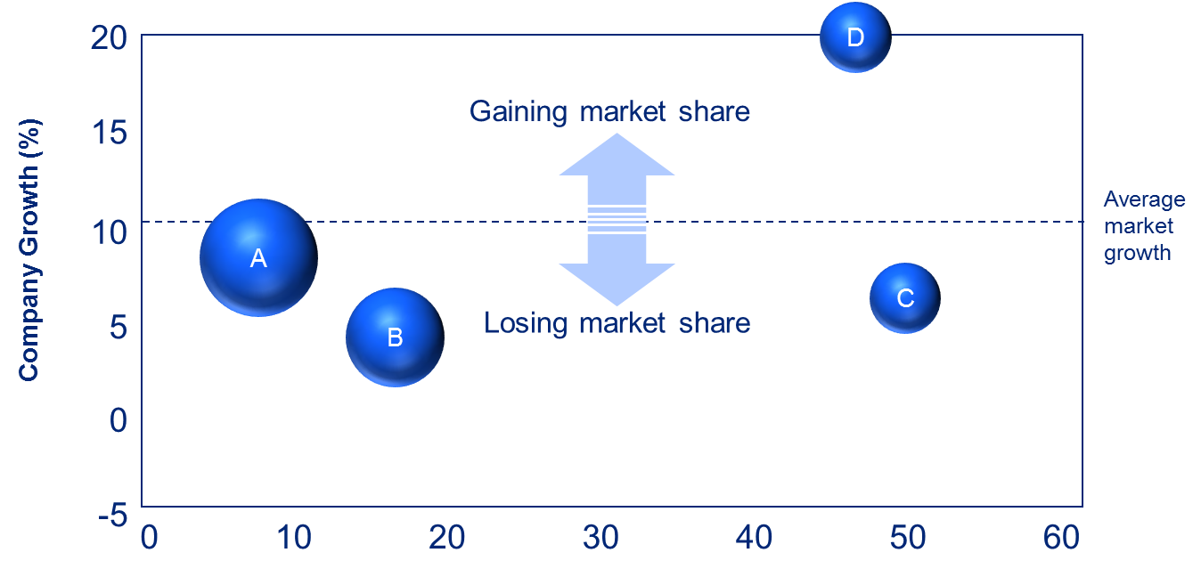

Commercial Due Diligence Overview and Approach
Confidential
By Former Deloitte and McKinsey Management Consultants

Slide 2

Table of Contents
1
Overview
2
The use of a hypothesis driven approach to undertake your CDD Project

Slide 3
Table of Contents
1
Overview
2
The use of a hypothesis driven approach to undertake your CDD Project

Slide 4
There are 3 key types of Due Diligence
Key question the Due Diligence tries to answer
Who usually performs the Due Diligence?
Financial Due Diligence
“What is the past and present performance of the company?”
The Financial Advisory team of a Consulting firm (i.e. Deloitte, KPMG, McKinsey)
1
Commercial Due Diligence
“What is the likely future performance of the company?”
The Strategy team of a Consulting firm (i.e. Deloitte, EY, McKinsey)
2
Legal Due Diligence
“Is there any legal/tax issues or opportunities the acquirer company needs to be aware of before making a decision?”
Business Lawyers from a law firm (i.e Ashurst)
3
These 3 key types of Due Diligence are usually initiated by the acquirer company. However sometimes the Commercial Due Diligence can be initiated by the Vendor or seller company. In that case the term “Vendor Due Diligence” is often used

Slide 5
A Commercial Due Diligence (CDD) is usually performed alongside a Financial Due Diligence and a Legal Due diligence
Due Diligence Focus
Commercial Due Diligence
External
Financial Due Diligence & Legal Due Diligence (i.e. past and present Income statements, Balance Sheet statements, Cash Flow statements, tax records, etc)
Internal
Past
Future

Slide 6
In the following slides, we will focus on the Commercial Due diligence
Commercial Due Diligence
External
Internal
Past
Future

Slide 7
A CDD should help investors answer 1 key question
Should we invest in this company in light of the future performance of the target company?

Slide 8
In order to answer this key question, the CDD will have to answer multiple sub-questions
Should we invest in this company in light of the future performance of the target company?
1.Landscape Analysis
2.Projection Assessment
3.Conclusion
Company
Strategy
Company key products and services
Company capabilities
Revenue
Cost structure
Profitability
Are revenue projections reasonable?
Company revenue drivers
Past revenue growth
Future revenue growth
Scenarios
Base case, upside case and downside case
Market
Market size and growth?
Market segments?
Market segments size and growth?
Market KPIs
Supplier an distribution landscape
Potential threats and opportunities
Are cost projections reasonable?
Company cost drivers
Past COGS & Operating cost
Future COGS & Operating cost
Challenges and risks
Potential challenges and risks to achieve projections
Competition
Competitive intensity
Company’s position in this market?
Exit options
Considerations of exit options
Customers
Segmentation
Price willing to pay by the customers for the company’s products and services?
Purchasing behavior
Trends

Slide 9



















The most common clients of a CDD are Banks, Private Equity Firms and Big Corporations
Banks
Private Equity Firms
Big Corporations

Slide 10








CDD services are usually provided by the top Consulting firms

Slide 11
There are many stakeholders involved in a transaction
Sell-side
Buy-side
Management team
Shareholders
Management team
Shareholders
Consulting firms (Vendor Due Diligence)
M&A Bankers
Consulting firms (Commercial Due Diligence)
Banking advisers
The target Business
Financial Advisers (Financial Due Diligence)
Legal Advisers (Legal due diligence)
Financial Advisers (Financial Due Diligence)
Experts (e.g. tax, human capital)

Slide 12
Table of Contents
1
Overview
2
The use of a hypothesis driven approach to undertake your CDD Project

Slide 13
The simplest way to undertake a CDD projects is to use a hypothesis driven approach
Frame the problem by breaking it into small pieces
Develop working hypothesis for resolution
Identify key assumptions that will
prove/disprove hypothesis
Refine hypothesis if necessary
Gather data
Analyse data to test key
assumptions of hypothesis
Draw conclusions and structure final deliverable

Slide 14
The simplest way to undertake a CDD projects is to use a hypothesis driven approach
Use logic trees to break down the problem into smaller pieces
Frame the problem by breaking it into small pieces
Develop working hypothesis for resolution
Use a Hypothesis tree including your hypothesis, assumptions, sub-assumptions, etc.
Identify key assumptions that will
prove/disprove hypothesis
Refine hypothesis if necessary
Gather data
Analyse data to test key
assumptions of hypothesis
Draw conclusions and structure final deliverable

Slide 15
Example of hypothesis
The Target Company profit forecasts provided by the Board are reasonable

Slide 16
Example of assumptions that must be true to validate our hypothesis
The projected Revenue is reasonable
The Target Company profit forecast provided by the Board is reasonable
The projected COGS is reasonable
The projected Operating Cost is reasonable

Slide 17
Example of sub-assumptions that must be true to validate our assumptions
There is no illogical trend between historic revenues and projected revenues
The projected Revenue is reasonable
The company core capabilities will support the future revenue growth
The revenue drivers have been identified correctly and projected in a reasonable way
The Target Company profit forecast provided by the Board is reasonable
The projected COGS is reasonable
The projected Operating Cost is reasonable

Slide 18
Once you’ve got your “Hypothesis tree” with your Hypothesis, Assumptions, Sub-Assumptions,…it is time to create your work plan
Work Plan to validate or invalidate your first hypothesis
For more details, open the Excel sheet “Work Plan”

Slide 19
Thanks for your attention!
www.domontconsulting.com

